Slide 1
INFS 5102 Unsupervised Methods in Analytics
Module 1 - Introduction

Slide 2
Outline
What is data analytics
Why is data analytics needed
The analytics process model
Main analytics tasks & techniques
Supervised (or predictive) tasks & methods
Unsupervised (or descriptive) tasks & methods
Challenges for data analytics/data mining
Analytics tools

Slide 3
What is analytics
Cambridge dictionary:
“a process in which a computer examines information using mathematical methods in order to find useful patterns”
Wikipedia:
“the discovery, interpretation, and communication of meaningful patterns in data”
“It also entails applying data patterns towards effective decision-making…Organizations may apply analytics to business data to describe, predict, and improve business performance.”
“analytics relies on the simultaneous application of statistics, computer programming and operations research to quantify performance.”
Gartner’s definition:
“Analytics has emerged as a catch-all term for a variety of different business intelligence (BI)- and application-related initiatives. For some, it is the process of analyzing information from a particular domain, such as website analytics. For others, it is applying the breadth of BI capabilities to a specific content area (for example, sales, service, supply chain and so on). In particular, BI vendors use the “analytics” moniker to differentiate their products from the competition.”
“Increasingly, “analytics” is used to describe statistical and mathematical data analysis that clusters, segments, scores and predicts what scenarios are most likely to happen.”
“Whatever the use cases, “analytics” has moved deeper into the business vernacular. Analytics has garnered a burgeoning interest from business and IT professionals looking to exploit huge mounds of internally generated and externally available data.”
Notes:
Gartner, Inc. is a research and advisory company, which delivers technology-related insights to its clients to make right decisions

Slide 4
What is analytics
All the above descriptions agree with each other in the sense that:
Analytics deals with data (and big data), to extract useful patterns or models
Analytics uses methods stemming from various areas
Analytics serves for business purposes
A note on terminology:
“Analytics is a terms that is often used interchangeably with data science, data mining, knowledge discovery, and others.” “The distinction between all those is not clear cut. All these terms essentially refer to extracting useful business patterns or mathematical decision models from a preprocessed data set.”
-- Bart Baesens, author of the book: “Analytics in a big data world; The essential guide to data science and its applications”

Slide 5
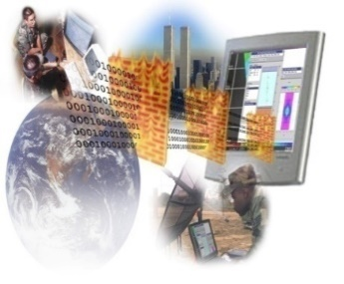

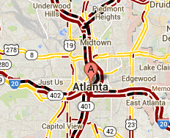
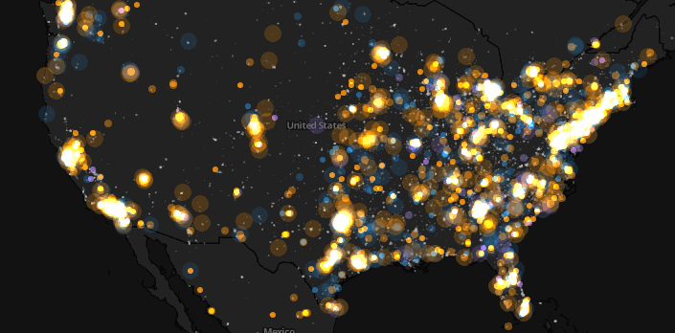
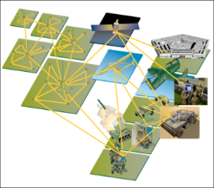
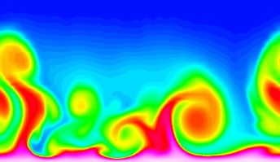
Large-scale data is everywhere!
There has been enormous data growth in both commercial and scientific databases due to advances in data generation and collection technologies
New mantra
Gather whatever data you can whenever and wherever possible
Expectations
Gathered data will have value either for the purpose collected or for a purpose not envisioned
E-Commerce
Cyber Security
Traffic Patterns
Social Networking: Twitter
Sensor Networks
Computational Simulations

Slide 6




Why data analytics? Commercial viewpoint
Lots of data is being collected and warehoused
Web data
Yahoo has Peta Bytes of web data
Facebook has billions of active users
Purchases at department or grocery stores, e-commerce
Amazon handles billions of visits/months (2021)
Bank/Credit card transactions
Computers have become cheaper and more powerful
Competitive pressure is strong
Provide better, customized services for an edge (e.g. in Customer Relationship Management)

Slide 7
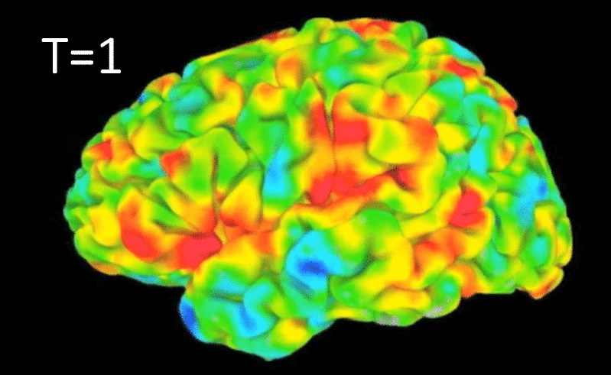
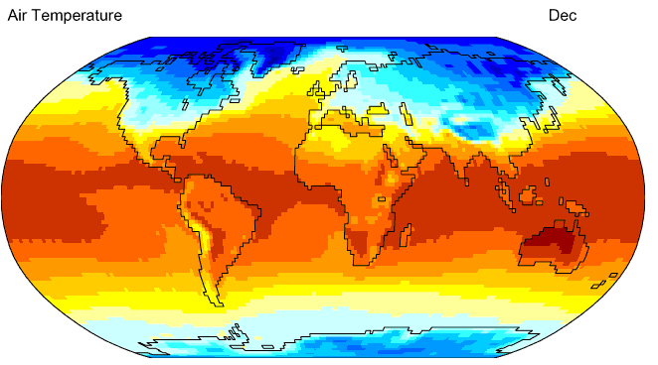
Why data analytics? Scientific viewpoint
Data collected and stored at enormous speeds
Remote sensors on a satellite
NASA EOSDIS archives over petabytes of earth science data / year
Telescopes scanning the skies
Sky survey data
High-throughput biological data
Scientific simulations
terabytes of data generated in a few hours
Data mining/analytics helps scientists
in automated analysis of massive datasets
In hypothesis formation
fMRI Data from Brain
Sky Survey Data
Surface Temperature of Earth
Gene Expression Data
Notes:
Earth Observing System Data and Information System (EOSDIS)

Slide 8

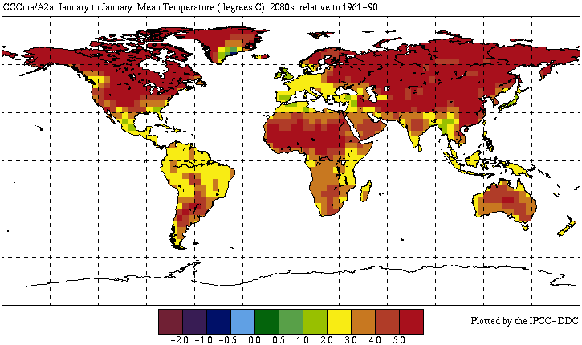


Great opportunities to solve society’s major problems
Improving health care and reducing costs
Predicting the impact of climate change
Finding alternative/ green energy sources
Reducing hunger and poverty by
increasing agriculture production

Slide 9
Why not traditional data analysis?
Tremendous amount of data
Algorithms must be highly scalable to handle large volume of data
High-dimensionality of data
Gene expression data, such as those generated using micro-array and next generation sequencing technologies may have tens of thousands of dimensions
High complexity of data
Data streams and sensor data
Time-series data, temporal data, sequence data
Structure data, graphs, social networks and multi-linked data
Heterogeneous databases and legacy databases
Spatial, spatiotemporal, multimedia, text and Web data
Software programs, scientific simulations
New and sophisticated applications

Slide 10
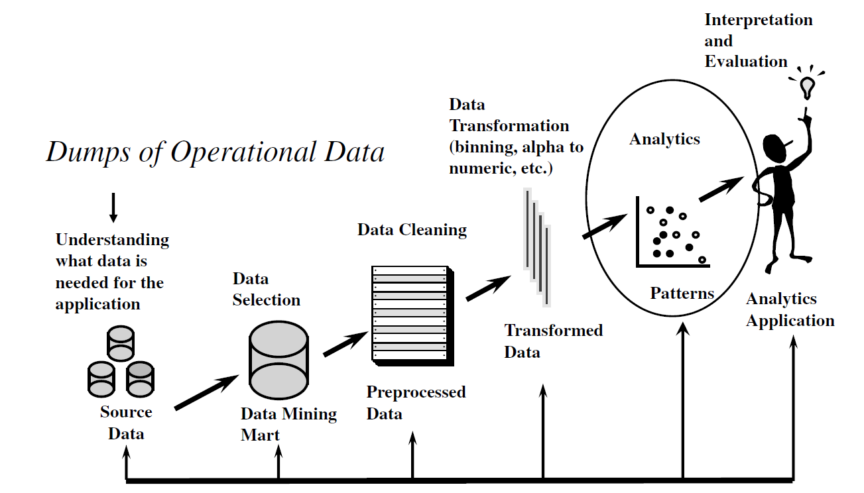
The analytics process model
Source: B. Baesens. Analytics in a Big Data World: The Essential Guide to Data Science and its Applications. Wiley, 2014

Slide 11
The analytics process model
Main steps:
Problem definition & Identification of data sources
Data selection/retrieval/collection
Data pre-processing: cleaning, transformation, reduction & integration
Analytics: methods selection and application
Interpretation and evaluation of results
Application of the results

Slide 12
The analytics process model
The process is iterative
Analytics is shown as one step in the process model, but other steps serve for or being served by the analytics step, and cannot be separated from the analytics step. Broadly speaking, one can consider analytics covers all the steps in the model
In the list on previous slide, I put cleaning and transformation in one step, data pre-processing, as they both are for getting data ready for the analytics step
The output of each step has increasing potential to support business decisions:
Source data → Data mining mart → Preprocessed data → Patterns → Analytics Application (decision made)

Slide 13
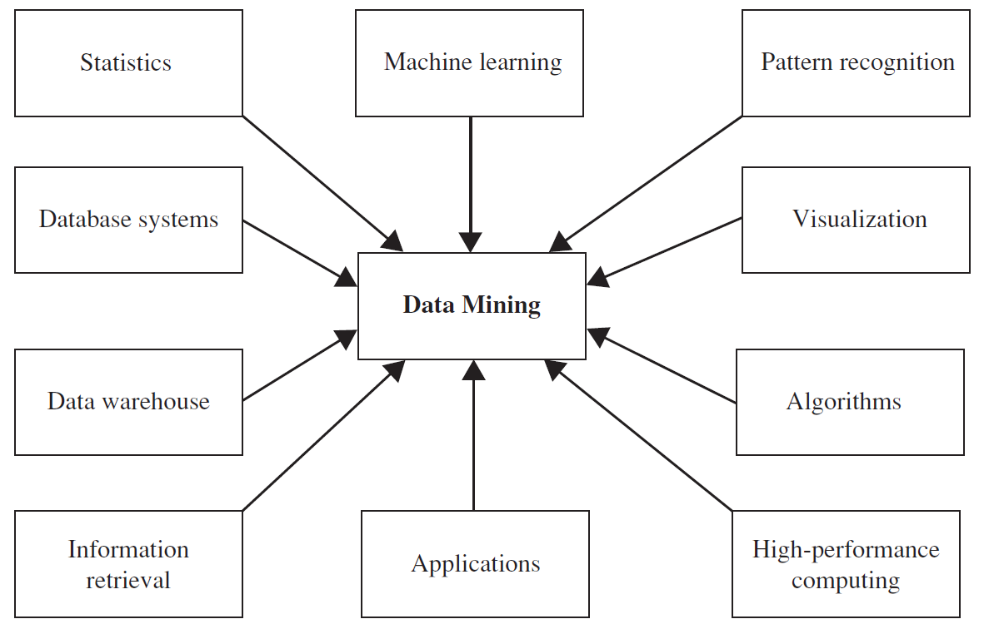
Analytics techniques
Data mining/analytics techniques are built upon methods from many other disciplines

Slide 14
Predictive vs. Descriptive analytics
Data analytics/mining tasks and methods generally fall in two major categories:
Predicative: Use some variables to predict unknown or future values of other variables
Descriptive: Find human-interpretable patterns that describe the data
Other categories include:
Semi-supervised learning: using both labelled and unlabelled samples
Active learning: user getting involved in the learning process
Prescriptive analytics: suggesting options for decision
Video: Thomas H. Davenport, professor at Babson College
http://hbr.org/video/2386816175001/business-analytics-defined

Slide 15
Predictive analytics
Also known as supervised learning, as labelled samples are used in training the predictive model
Methods:
Classification: assigning objects to one of several predefined categories/classes
Decision tree
Neural networks
Support vector machine
Naïve Bayes classifier
Regression: the target variable is continuous

Slide 16
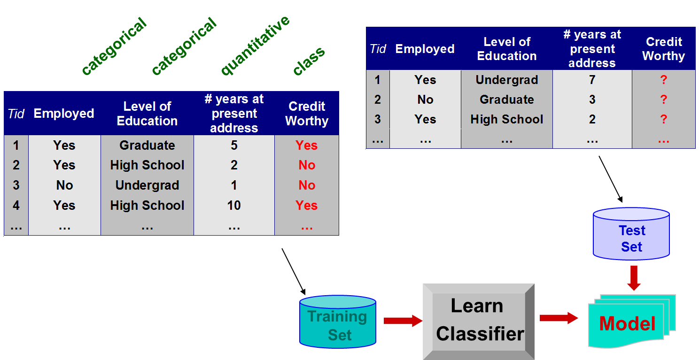
Classification
Given a collection of records or samples (training set )
Each record contains a set of attributes, one of the attributes is the class. → the record is labelled with the value of the class attribute
Find a model for the class attribute as a function of the values of other attributes
A test set is used to determine the accuracy of the model. Usually, the given data set is divided into training and test sets, with training set used to build the model and test set used to validate it
Goal/use of the model: previously unseen records should be assigned a label/class as accurately as possible by using the model

Slide 17

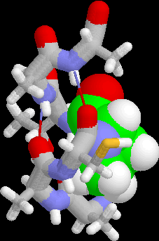
Examples of classification task
Classifying credit card transactions as legitimate or fraudulent
Classifying land covers (water bodies, urban areas, forests, etc.) using satellite data
Categorizing news stories as finance, weather, entertainment, sports, etc
Identifying intruders in the cyberspace
Predicting tumor cells as benign or malignant
Classifying secondary structures of protein as alpha-helix, beta-sheet, or random coil

Slide 18
Regression
Predict a value of a given continuous valued variable based on the values of other variables, assuming a linear or nonlinear model of dependency
Greatly studied in statistics, neural network fields
Examples:
Predicting sales amounts of new product based on advertising expenditure
Predicting wind velocities as a function of temperature, humidity, air pressure, etc.
Time series prediction of stock market indices

Slide 19
Descriptive analytics
Also known as unsupervised learning, as samples are not labelled
→ Topic of this course, INFS 5102
Example/main tasks:
Cluster analysis
Association analysis
Anomaly/outlier detection
Techniques:
Clustering methods: K-means, hierarchical, density-based methods, etc.
Frequent pattern & association rule mining algorithms: Apriori, FP-Growth, etc.
Anomaly detection: statistical approaches, clustering based techniques, etc.

Slide 20
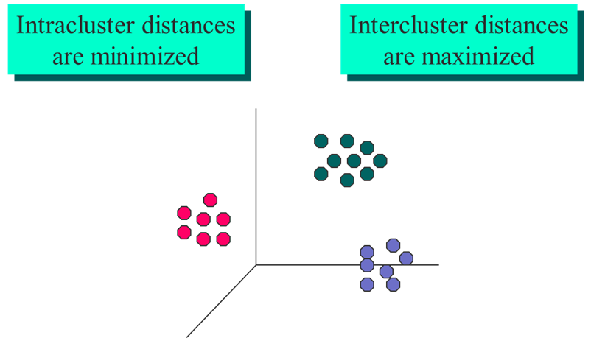
Clustering (Cluster analysis)
Given a set of data points, each having a set of attributes, and a similarity measure among them, find clusters such that
Data points in one cluster are more similar to one another
Data points in separate clusters are less similar to one another
Similarity Measures:
Euclidean Distance if attributes are continuous
Other problem-specific measures

Slide 21
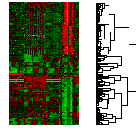
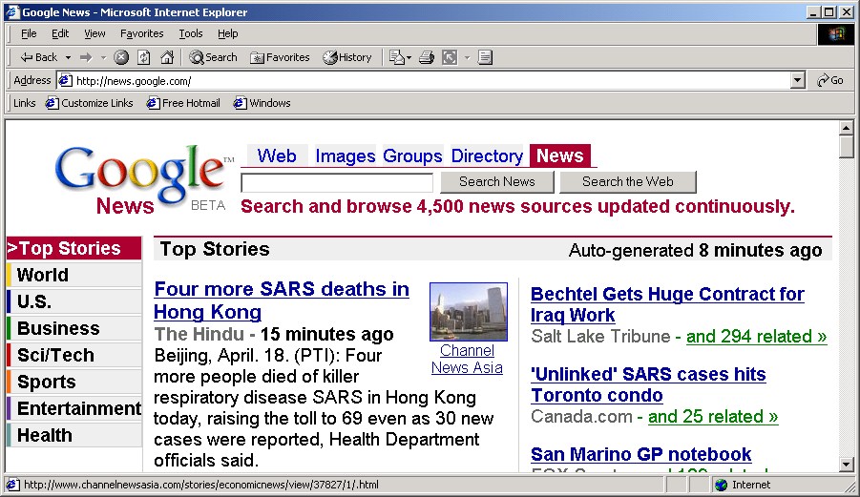
Purpose of clustering
Understanding
Custom profiling for targeted marketing
Group related documents for browsing
Group genes and proteins that have similar functionality
Group stocks with similar price fluctuations
Summarization
Reduce the size of large data sets
Courtesy: Michael Eisen
Use of K-means to partition Sea Surface Temperature (SST) and Net Primary Production (NPP) into clusters that reflect the Northern and Southern Hemispheres.

Slide 22
Clustering: Example application 1
Market Segmentation:
Goal: subdivide a market into distinct subsets of customers where any subset may conceivably be selected as a market target to be reached with a distinct marketing mix
Approach:
Collect different attributes of customers based on their geographical and lifestyle related information
Find clusters of similar customers
Measure the clustering quality by observing buying patterns of customers in same cluster vs. those from different clusters

Slide 23
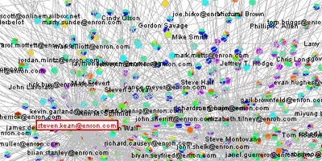
Clustering: Example application 2
Document Clustering:
Goal: To find groups of documents that are similar to each other based on the important terms appearing in them
Approach: To identify frequently occurring terms in each document. Form a similarity measure based on the frequencies of different terms. Use it to cluster
Enron email dataset
Notes:
https://en.wikipedia.org/wiki/Enron_Corpus

Slide 24
Association rule discovery
Given a set of records each of which contain some number of items from a given collection
Produce dependency rules which will predict occurrence of an item based on occurrences of other items
Rules Discovered:
{Milk} --> {Coke}
{Diaper, Milk} --> {Beer}

Slide 25
Association rule discovery: Example application
Supermarket shelf management
Goal: To identify items that are bought together by sufficiently many customers.
Approach: Process the point-of-sale data collected with barcode scanners to find dependencies among items.
A classic rule:
If a customer buys diaper and milk, then he is very likely to buy beer.
So, don’t be surprised if you find six-packs stacked next to diapers!

Slide 26
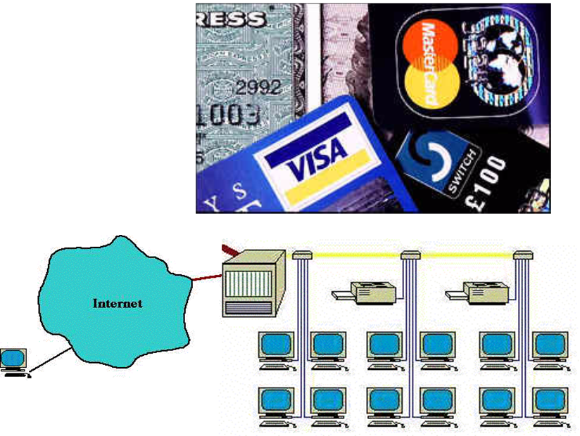
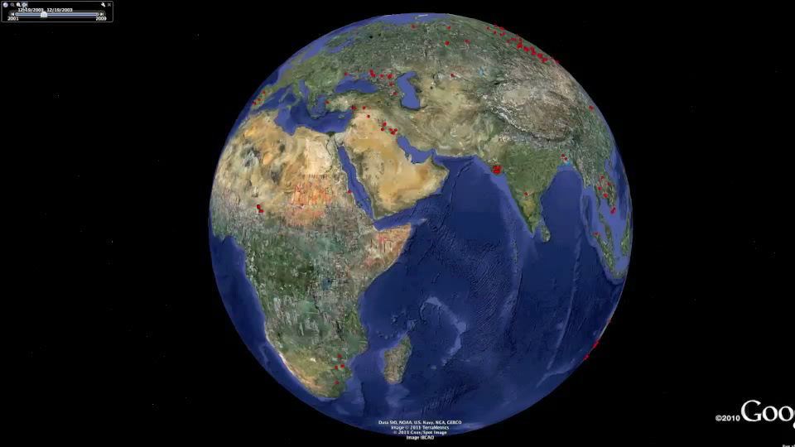
Outlier/Anomaly detection
Detect significant deviations from normal behavior
Applications:
Credit card fraud detection
Network intrusion detection
Identify anomalous behavior from sensor networks for monitoring and surveillance
Detecting changes in the global forest cover

Slide 27
Challenges of data mining/analytics
Scalability
Dimensionality
Complex and heterogeneous data
Data quality
Data ownership and distribution
Non-traditional analysis

Slide 28
Tools
Statistics
SPSS, SAS, and R
Database vendors
Oracle and IBM Db2
Computing
Weka (Java)
Rattle (R)
Orange data mining (Python)
RapidMiner
Other lists:
http://www.kdnuggets.com/software/suites.html
https://www.kdnuggets.com/2020/06/data-science-tools-popularity-animated.html

Slide 29
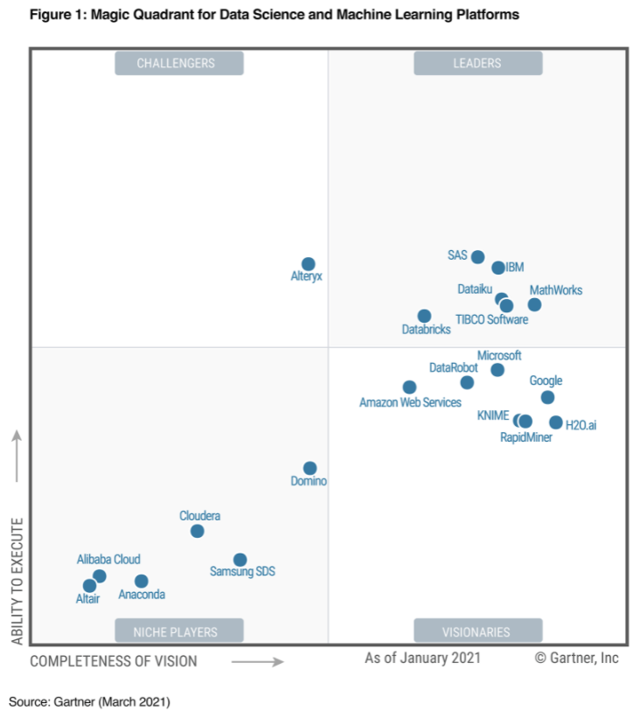
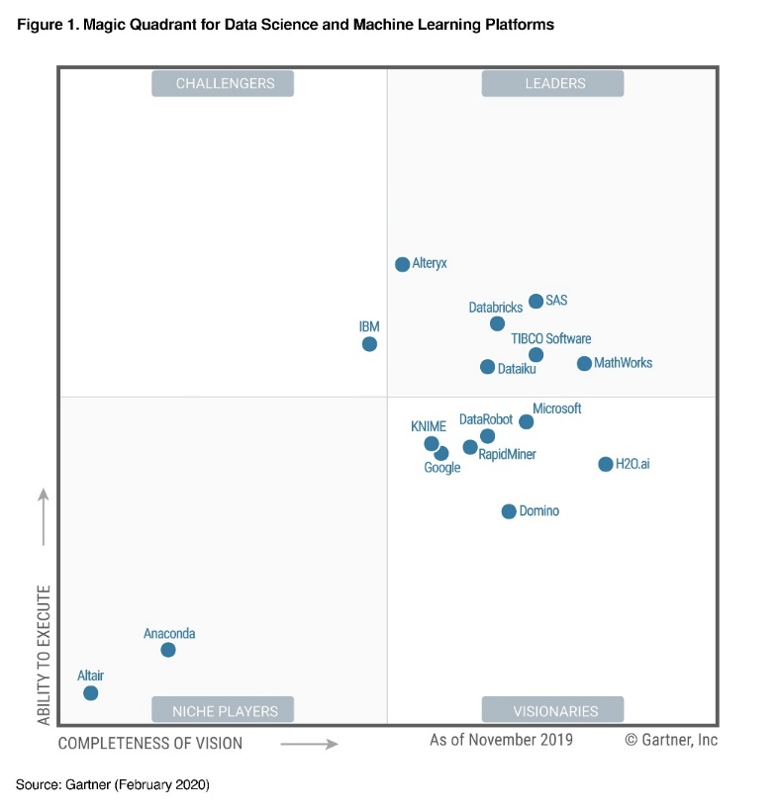
Tools

Slide 30
SAS Enterprise Miner
SAS (previously "Statistical Analysis System") is a statistical software suite developed by SAS Institute
SAS suite contains 200+ components
SAS Enterprise Miner (SAS EM) is one of the components, and it is a data mining tool
SAS EM has been developed to support the entire data mining process
In this course, we will be using SAS EM as the main software tool.

Slide 31
SAS Enterprise Miner
SAS EM operates with a client-server architecture. Users need to run a SAS EM client program to access a SAS EM server where the data analytics jobs are done
SAS EM functions are organized into a process known as SEMMA:
Sample the data by creating one or more data tables. The samples should be large enough to contain the significant information, yet small enough to process.
Explore the data by searching for anticipated relationships, unanticipated trends, and anomalies in order to gain understanding and ideas.
Modify the data by creating, selecting, and transforming the variables to focus the model selection process.
Model the data by using the analytical tools to search for a combination of the data that reliably predicts a desired outcome.
Assess the data by evaluating the usefulness and reliability of the findings from the data mining process.

Slide 32
SAS Enterprise Miner
Within each of the SEMMA categories, SAS EM provides a number of tools (nodes) to support the process of data mining
Watch the video on SAS SEMMA prcess: https://support.sas.com/en/software/enterprise-miner-support.html

Slide 33
SAS Enterprise Miner
Project:
Analyses in SAS EM start by defining a project
A project is a container for a set of related analyses
Library & Data source:
A library is a collection of data sources accessible by the SAS Server, and it connects SAS EM with the raw data sources for analysis
For this course, we will use the data sources in existing libraries on the SAS server
A data source defines all the information about a SAS data set, including the name and location of the data set, the SAS code that is used to define a library path, the variable roles, the measurement levels, and other attributes that guide the data mining process
Diagram:
A diagram holds analyses for one or more data sources
Process flow & Node:
A process flow is a sequence of tasks or nodes connected by arrows in the user interface , and it defines the order of analysis of a data source.
Each step in a process flow is indicated by a node (also called a SAS EM tool)

Slide 34
Readings
Chapter 1, P.-N. Tan, M. Steinbach, and V. Kuma. Introduction to Data Mining. Addison-Wesley.
Chapter 1, B. Baesens. Analytics in a Big Data World: The Essential Guide to Data Science and its Applications. Wiley, 2014. URL: http://www.sas.com/storefront/aux/en/spbdadatasci/67283_excerpt.pdf (whole book available online via UniSA library)

Slide 35
References
Most of the slides are from or have their materials taken from the following sources (unless otherwise indicated):
https://www-users.cs.umn.edu/~kumar001/dmbook/firsted.php
https://www-users.cs.umn.edu/~kumar001/dmbook/index.php
http://web.engr.illinois.edu/~hanj/bk3/

